Slide 1
Param Input

Slide 2





Agenda
Data Add
Param Input

Slide 3

1. Data Add

Slide 4

Basic concept
Two input files
Merging
Notes:
Two input files need to be merged, but the merging is just pasting the second file to the end of the first file
No referencing (1-1 Merge, 1-Many Merge) based on variables takes place.

Slide 5

2. Param Input

Slide 6
Basic concept
Variable creation where the default value can be changed.
Before production but wish to maintain the layout design.
These variables are like any other variable coming from a data file.
Notes:
The ParamInput Module enables you to create a variable where the default value can be changed.
You would do this if you want to modify a variable before production but wish to maintain the layout design.
In all other respects, these variables are like any other variable coming from a data file.

Slide 7
Param Input
Default values can be changed in two ways:
    From the Production Window
    By setting the value in the command line when starting console version.
Notes:
Default values can be changed in two ways:
From the Production Window
By setting the value in the command line when starting console version.

Slide 8
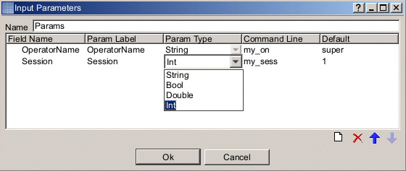
Param Input
Variable name shown in the layout tree
Variable name shown in Production window
Type of variable
Parameter name used in the command line
The default variable value
Notes:
The name of the variable that will be shown in the layout tree
The name of the variable that will be shown in Production window
Defines the type of variable
The parameter name used in the command line when you start the console version
The default variable value
Example of a console command: PrintNetTC.exe 1_3_ParamInput.wfd –GenderParameters f –e PDF

Slide 9
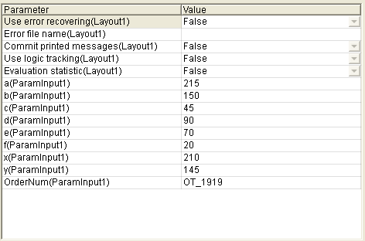
Parameters in the Production
Show workflow parameters in the Window menu.
Changes of parameters are not saved automatically.
Notes:
The Workflow Parameters panel displays when you select Show workflow parameters in the Window menu.
Changes of parameters are not saved automatically. You can save them to the .JOB file from the menu Production | Save Production Configuration.

Slide 10

Any Questions? Thank You.

